Slide 1
Session 2 introduction to probability theory

Slide 2
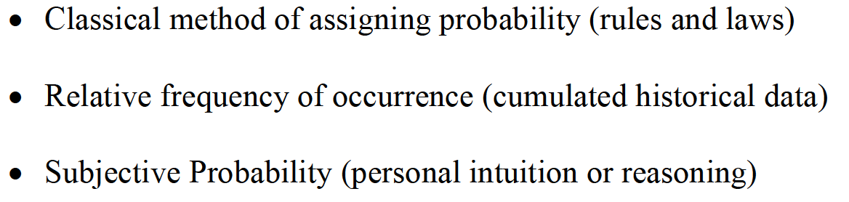
METHODS OF ASSIGNING PROBABILITIES

Slide 3

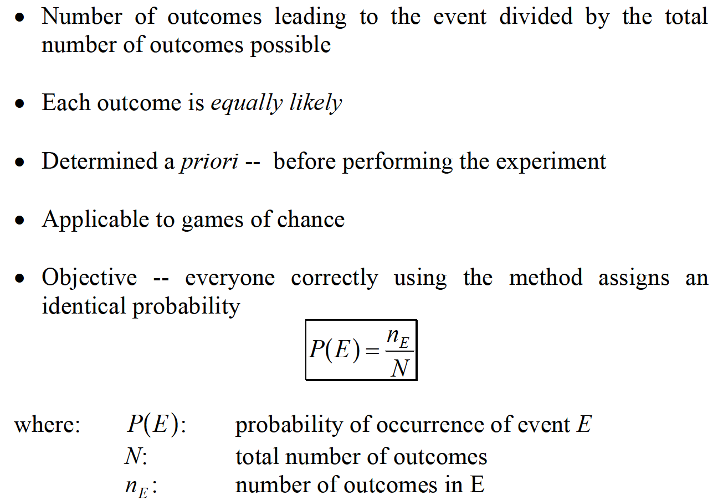
METHODS OF ASSIGNING PROBABILITIES

Slide 4
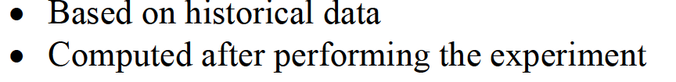
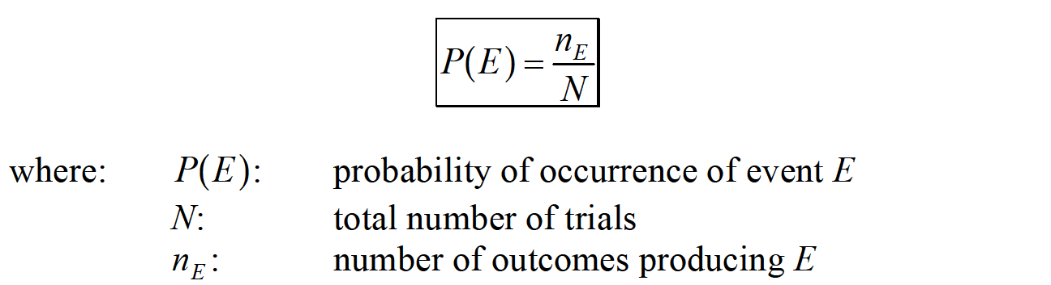
METHODS OF ASSIGNING PROBABILITIES

Slide 5

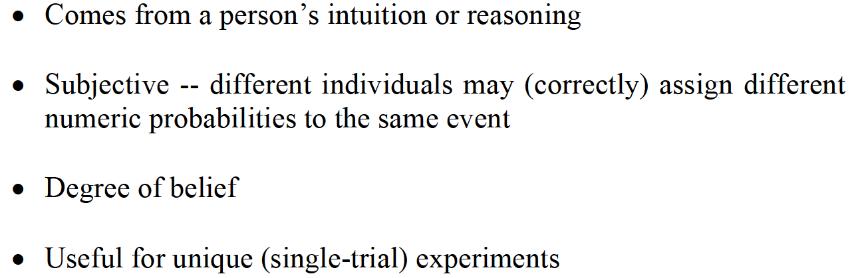
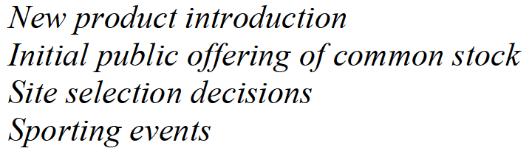
METHODS OF ASSIGNING PROBABILITIES

Slide 6
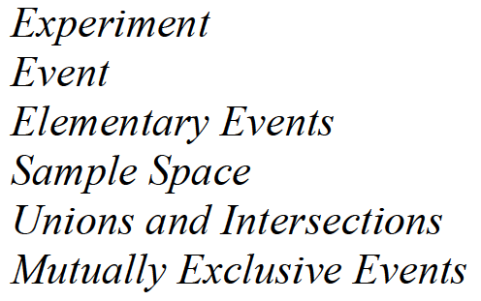
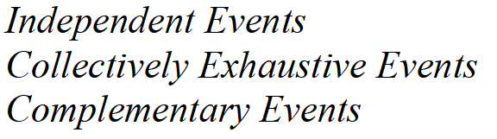
STRUCTURE OF PROBABILITY

Slide 7
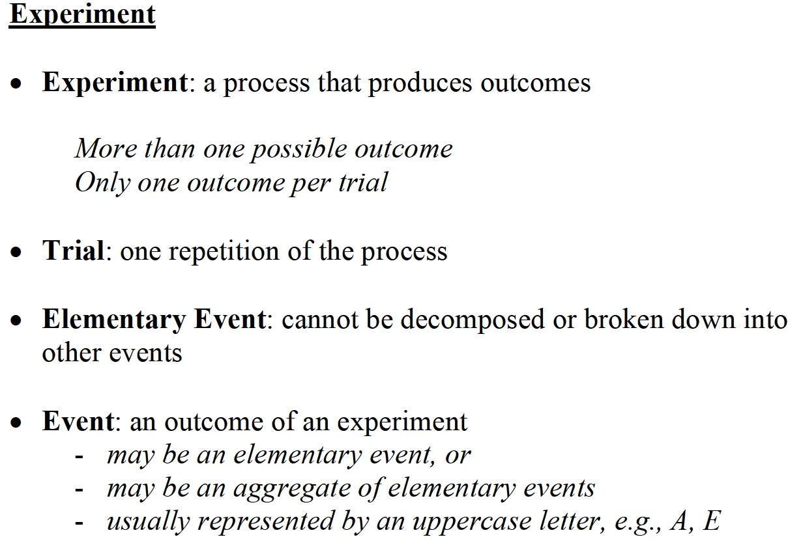
STRUCTURE OF PROBABILITY

Slide 8

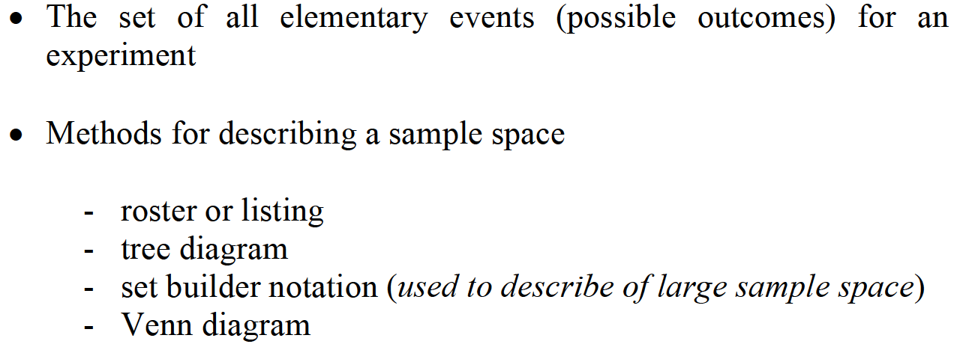
STRUCTURE OF PROBABILITY

Slide 9
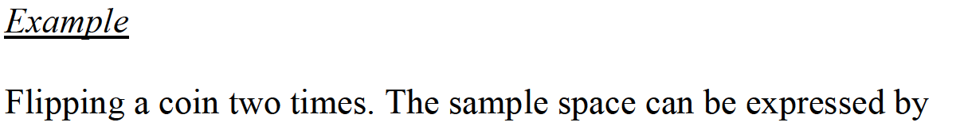
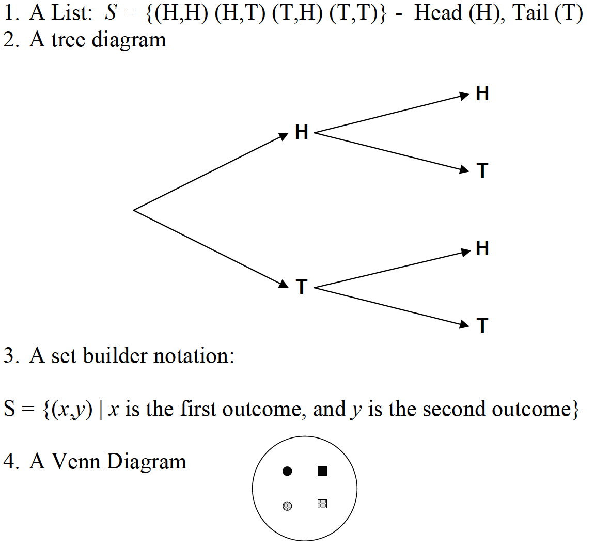
STRUCTURE OF PROBABILITY

Slide 10
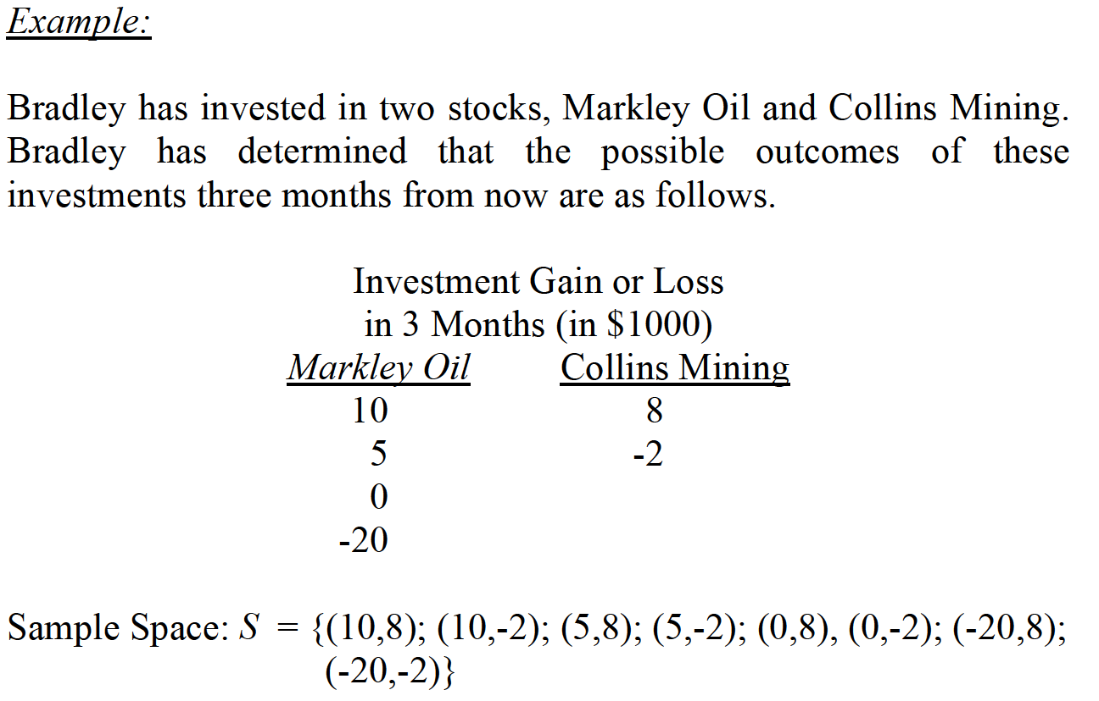
STRUCTURE OF PROBABILITY

Slide 11
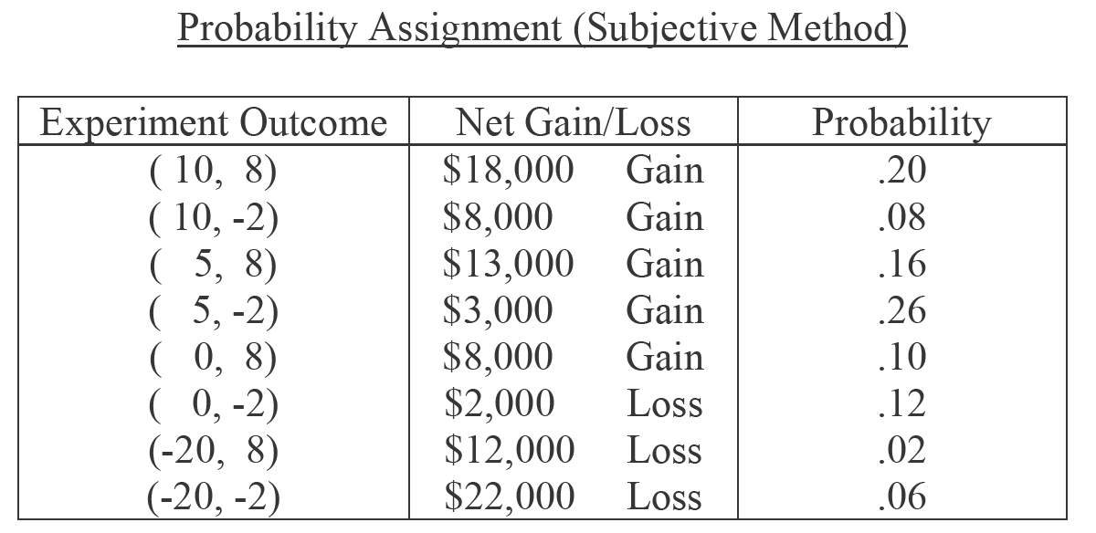
STRUCTURE OF PROBABILITY

Slide 12
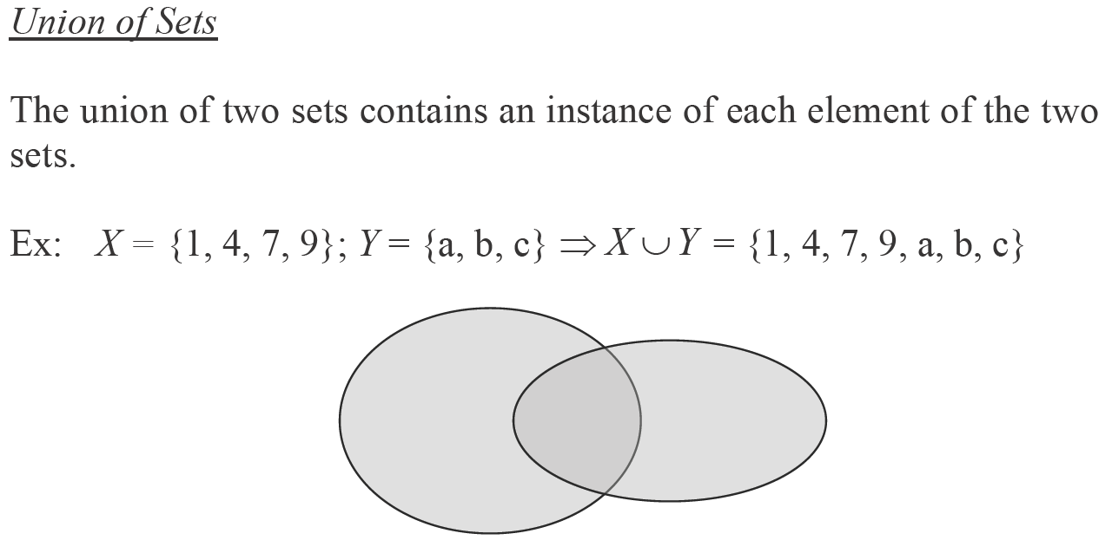
OPERATIONS ON SET

Slide 13
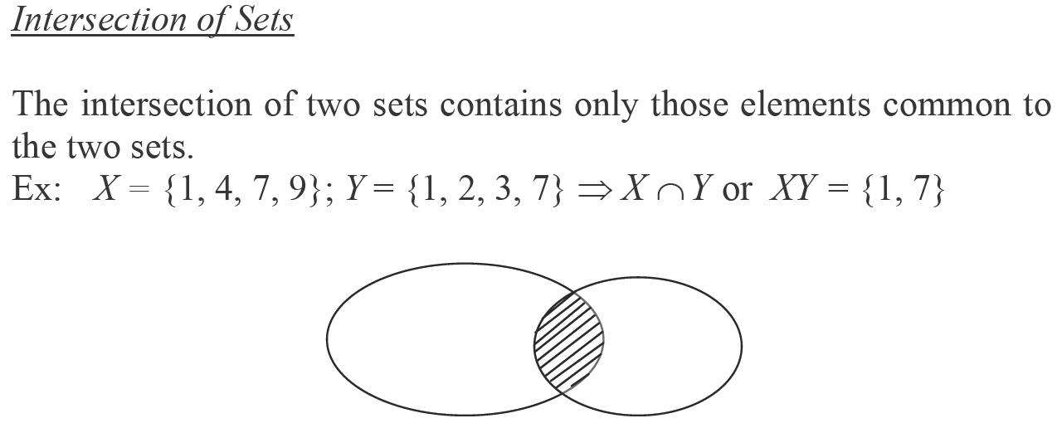
OPERATIONS ON SET

Slide 14
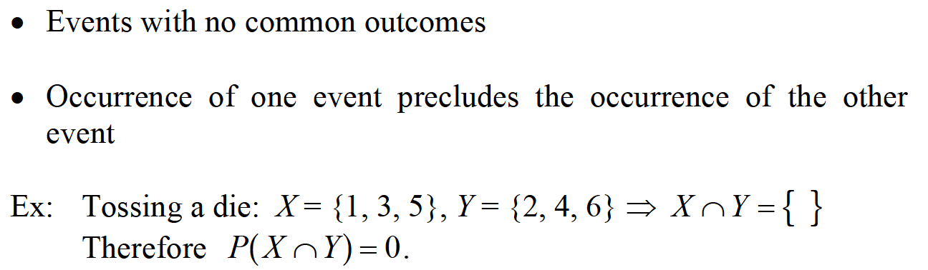
MUTUALLY EXCLUSIVE EVENTS

Slide 15
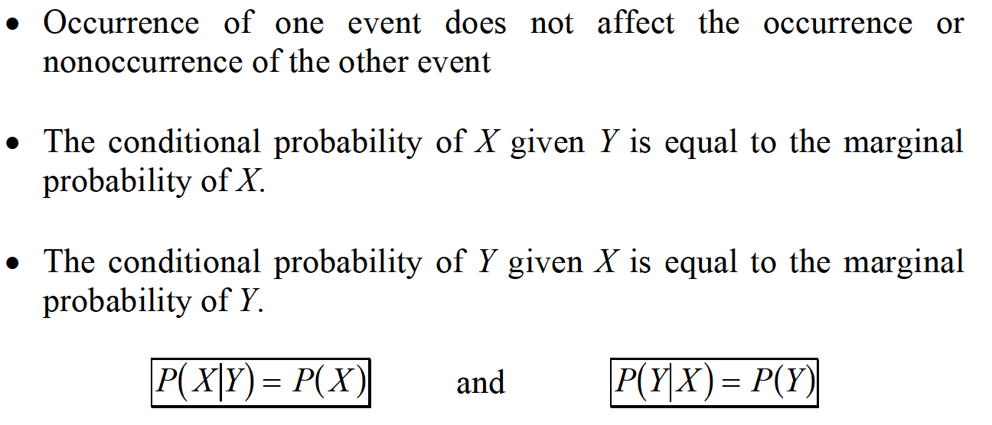
INDEPENDENT EVENTS

Slide 16
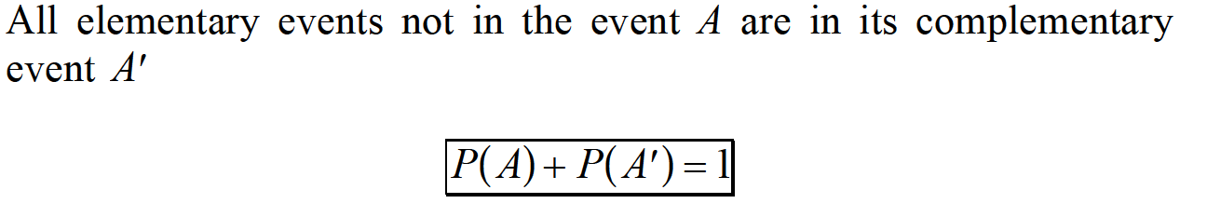
COMPLEMENTARY EVENTS

Slide 17

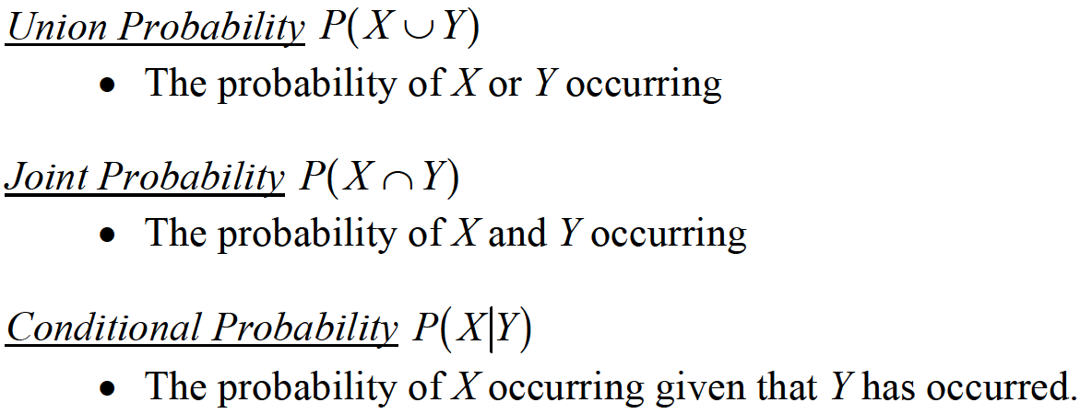
TYPES OF PROBABILITY

Slide 18
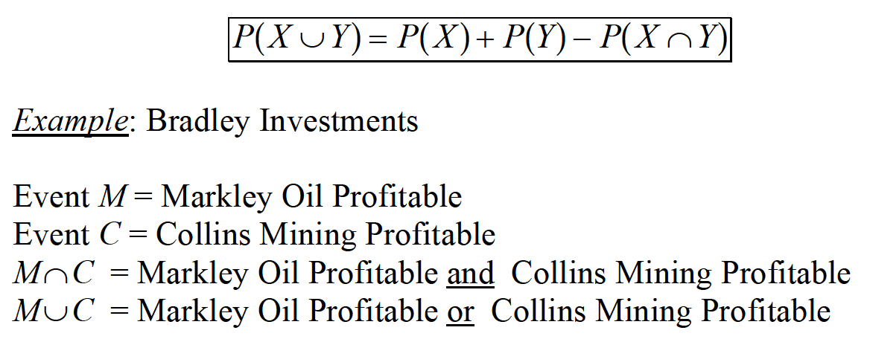
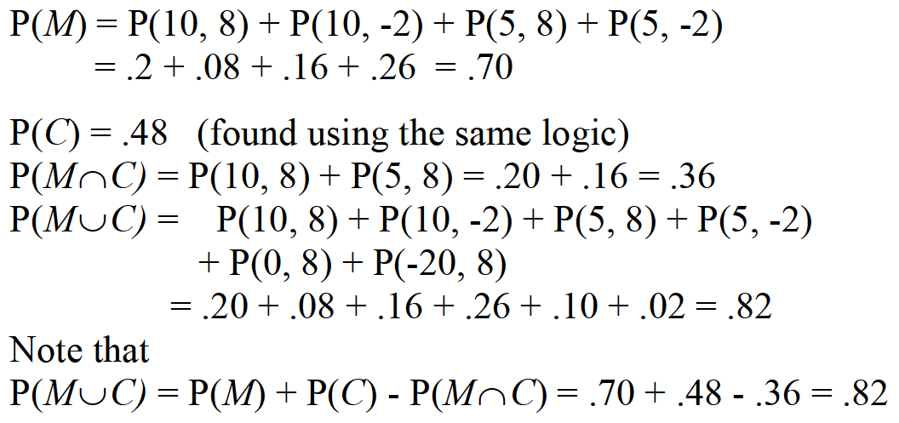
GENERAL LAW OF ADDITION

Slide 19
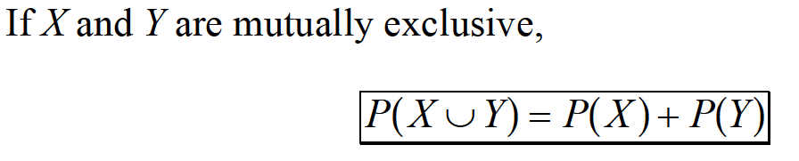
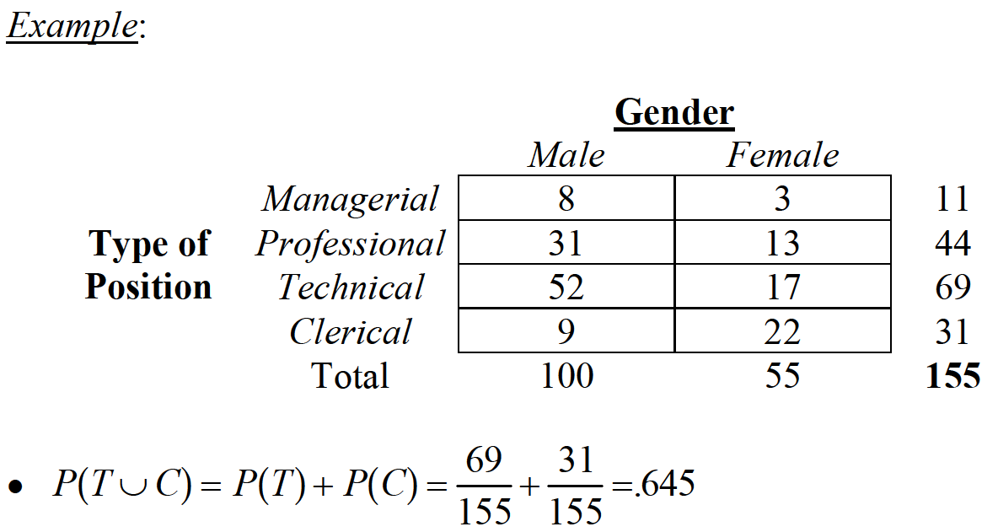
SPECIAL LAW OF ADDITION

Slide 20


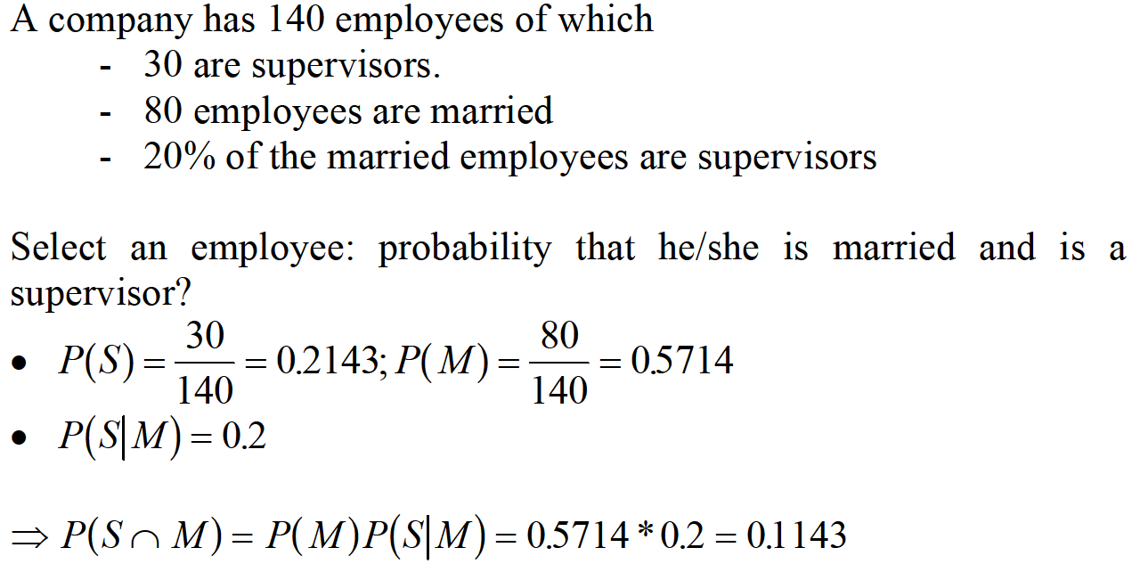
GENERAL LAW OF MULTIPLICATION

Slide 21


SPECIAL LAW OF MULTIPLICATION –FOF INDEPENDENT EVENTS

Slide 22
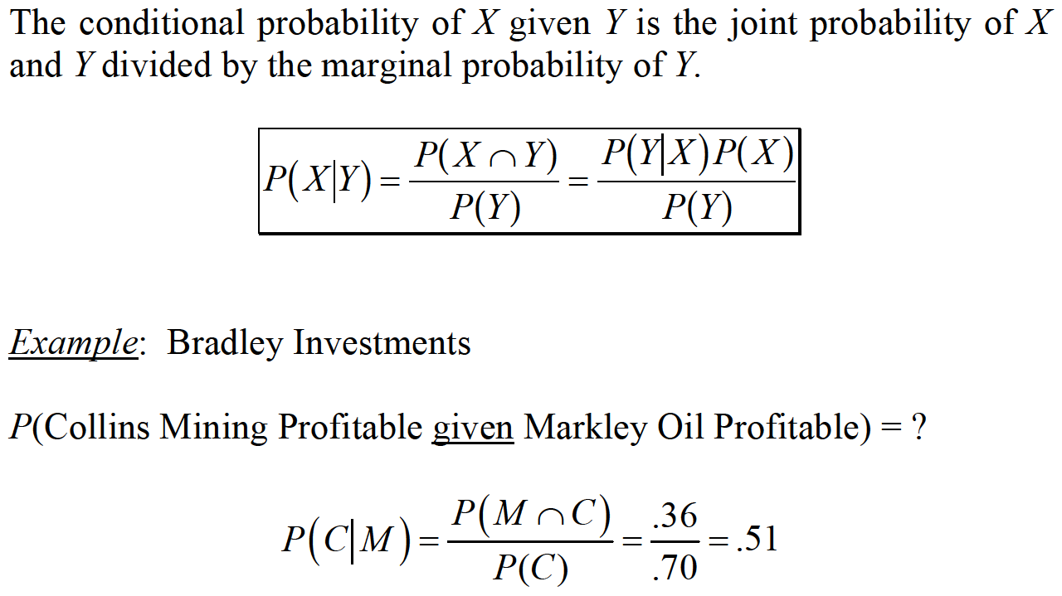
LAW OF CONDITIONAL PROBABILITY

Slide 23
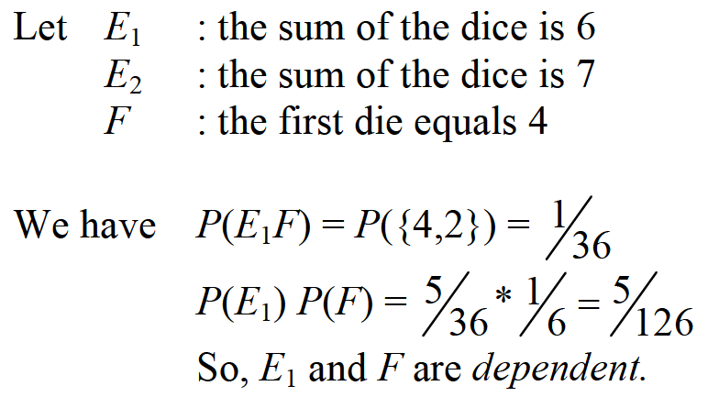
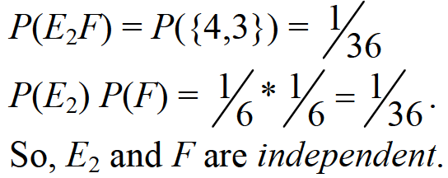
INDEPENDENT EVENTS

Slide 24
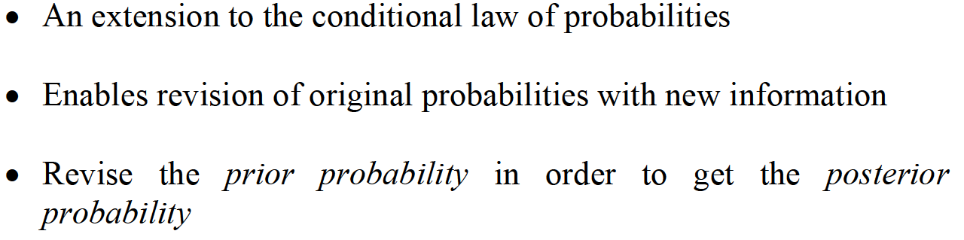
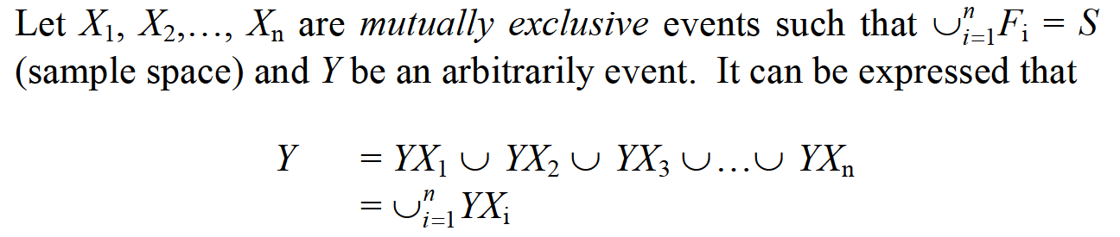
REVISIONS OF PROBABILITY – THE BAYES’ RULE

Slide 25
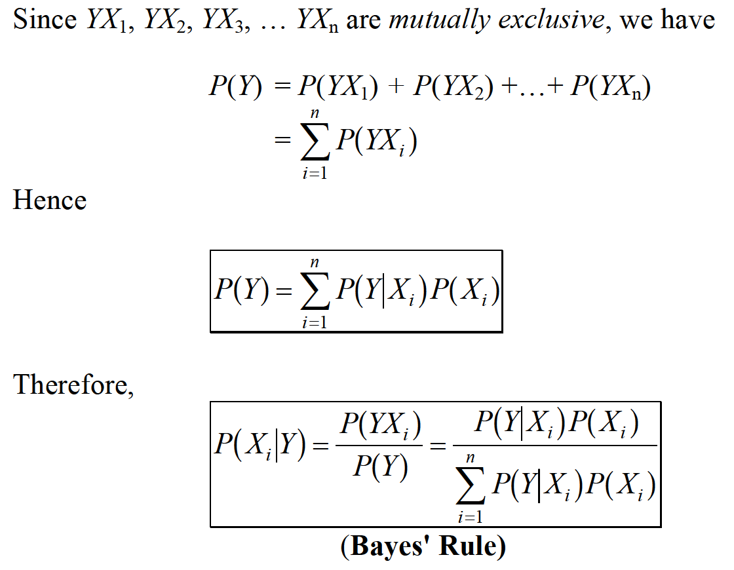
REVISIONS OF PROBABILITY – THE BAYES’ RULE

Slide 26

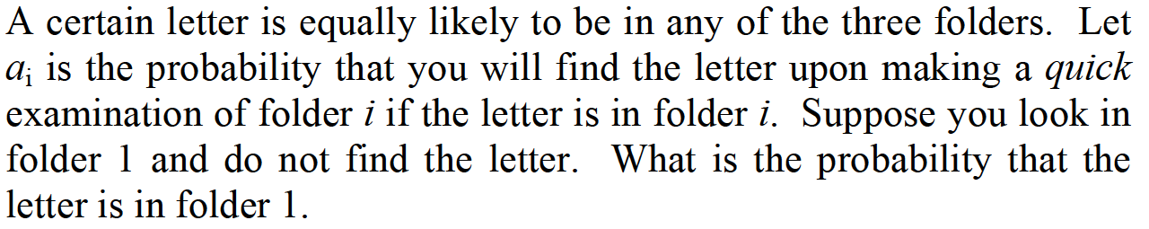
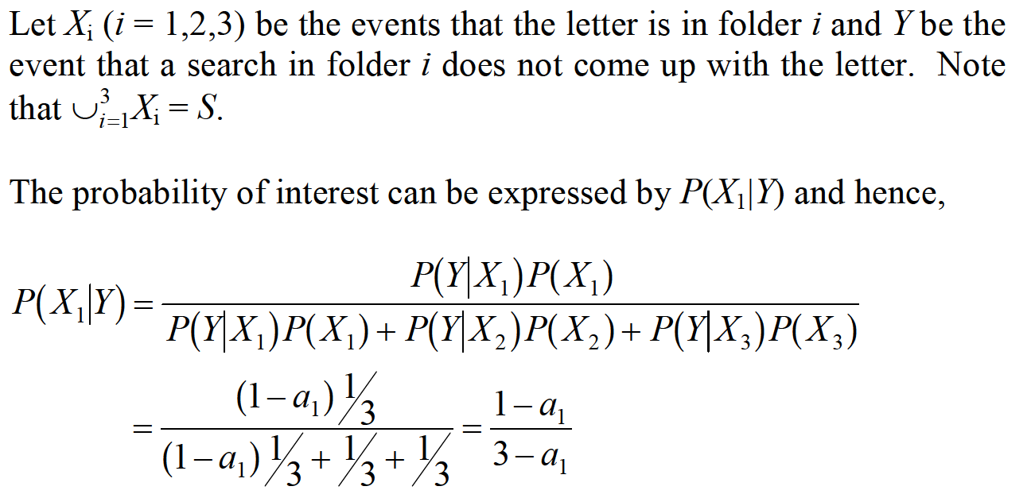
REVISIONS OF PROBABILITY – THE BAYES’ RULE

